Slide 1
C&S Fall 2025 Hackathon
Code. Create. Ideate. Compete. Collaborate.
Registration/Idea Submission: Oct 1 – Oct 17
Hackathon Event: Oct 29 – Oct 30​
Presentations/Judging: Nov 5 – Nov 6​
Announcement/Results: Nov 10 – Nov 14

Slide 2
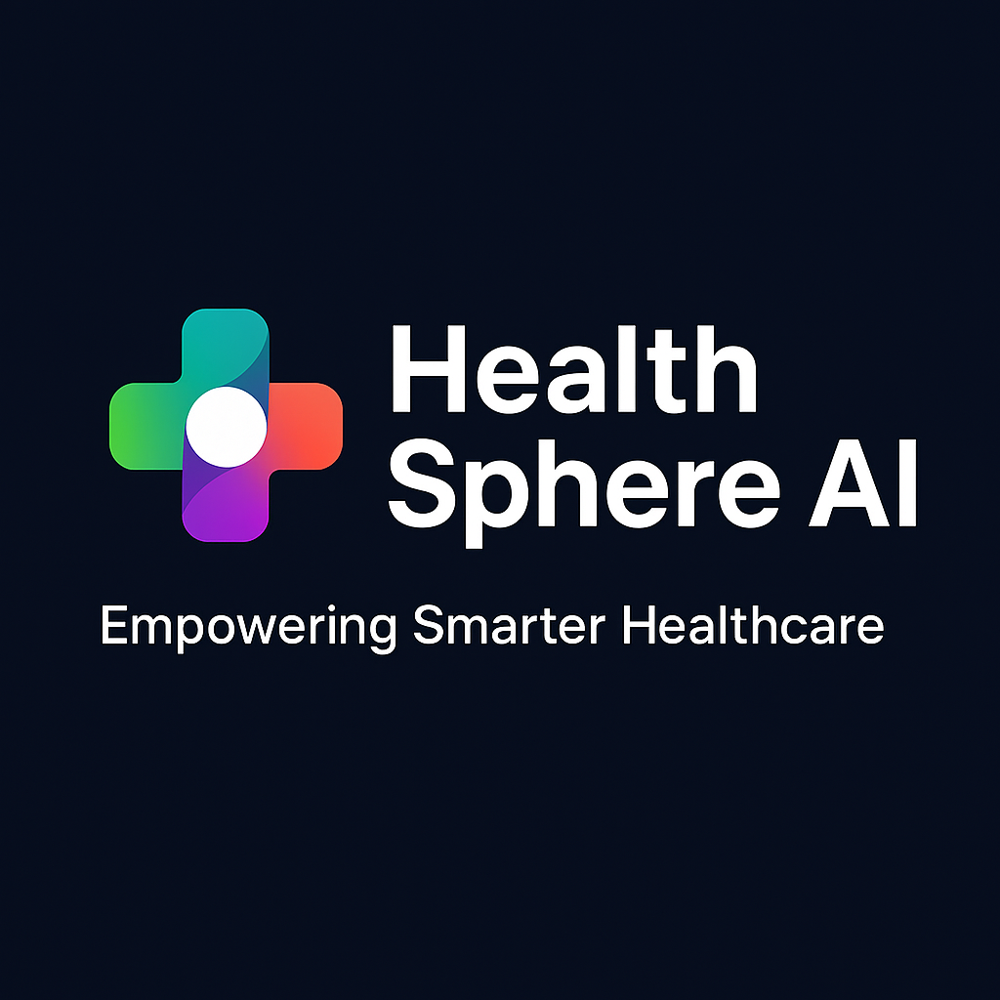
Team Name:
Idea | HealthSphere AI
Goal & Theme | 60° Simulation for Safer AI Adoption.
Team Members | Monal Agarwal

Slide 3
Idea/Problem Statement
Current Challenge: Hospitals and developers lack a safe, controlled environment to evaluate AI models before deployment in real-world healthcare workflows.
Impact: Without proper testing, models may lead to inefficiencies, compliance risks, and poor patient outcomes.
Proposed Solution:
AI Sandbox for Healthcare Workflows
Upload or select AI models for evaluation
Compare performance metrics (accuracy, latency, resource usage)
Simulate healthcare workflows with integrated AI
Visualize resource utilization and explainability
Goal: Enable stakeholders to make informed decisions about AI adoption, ensuring safety, compliance, and efficiency.

Slide 4
Process Flow/Solution Overview
Model Ingestion
  Users upload AI models or select from pre-integrated options.
  Models are validated for compatibility and compliance.
Workflow Simulation
  Configure healthcare workflows (e.g., patient intake, diagnosis, treatment planning).
  Integrate selected AI models into the simulated workflow.
Performance Evaluation
  Compare models on key metrics:
    Accuracy & precision
    Latency & resource utilization
    Compliance & risk indicators
Explainability & Insights
  Generate interpretability reports (feature importance, prediction rationale).
  Visualize resource usage and operational impact.
Decision Support
  Provide dashboards for stakeholders to:
    Select best-fit models
    Forecast ROI and operational efficiency
    Ensure regulatory compliance before deployment

Slide 5
Implementation Details
Tech Stack
Frontend: React.js for UI, integrated with Material UI for design consistency.
Backend: Python (FastAPI) for API services.
AI Models: TensorFlow / PyTorch for model integration and evaluation.
Database: Azure SQL / PostgreSQL for storing model metadata and workflow configurations.
Cloud & Deployment: Azure Kubernetes Service (AKS) for container orchestration, Azure Blob Storage for artifacts.

Slide 7
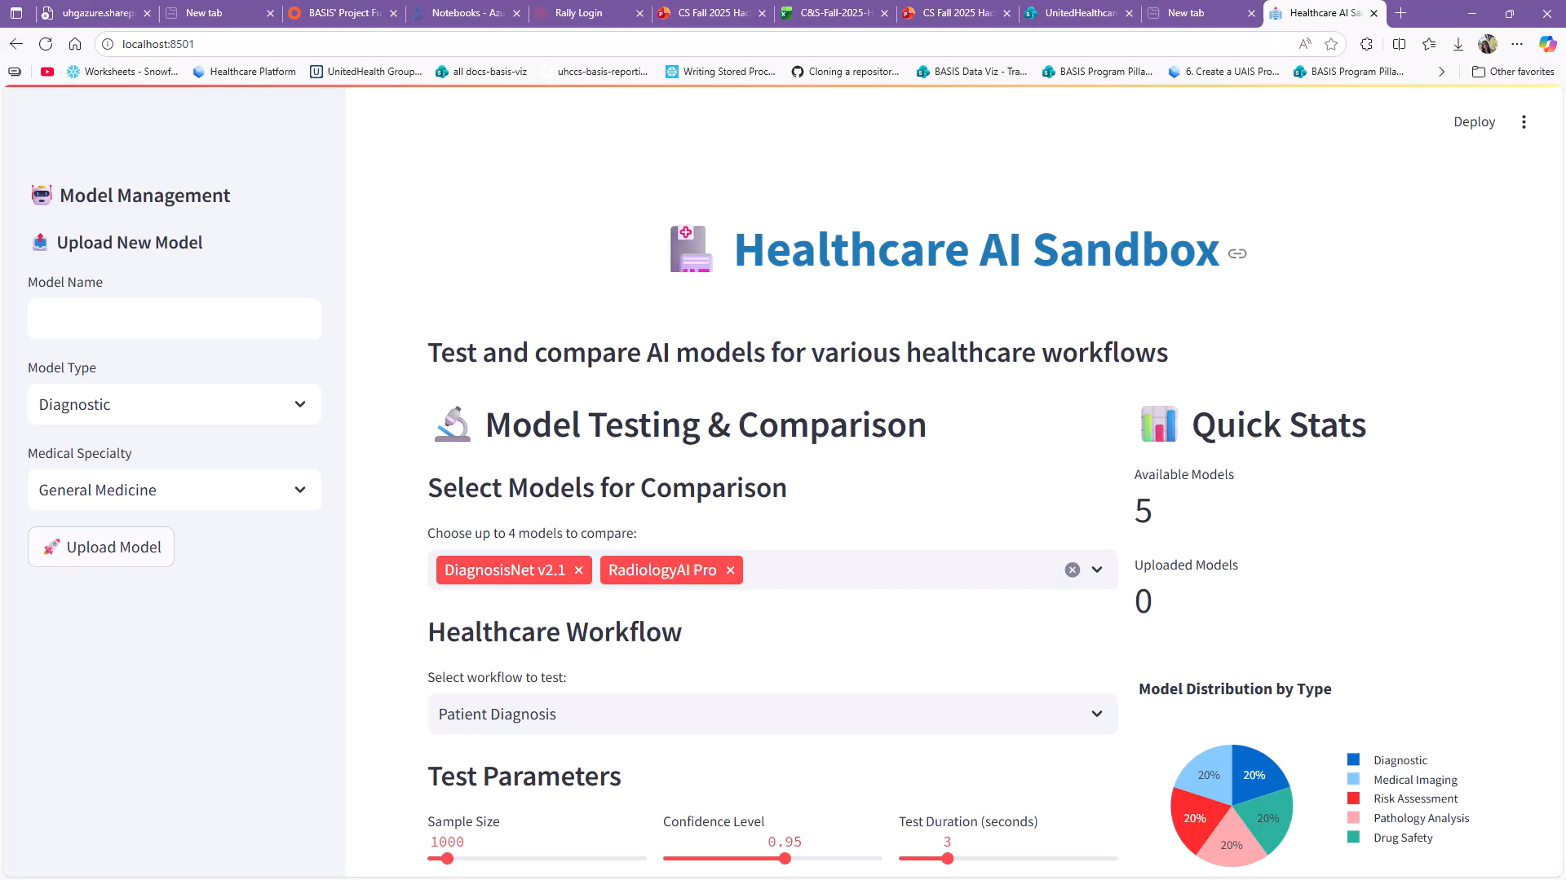

Slide 8
Proposed Benefits
Overall Value to Customers, Constituents, Business, IT
Customers (Hospitals & Providers):
  Reduce risk of deploying ineffective AI models by testing in a controlled environment.
  Improve patient care through better model selection and workflow optimization.
Business:
  Accelerates AI adoption in healthcare, creating new revenue streams.
  Enhances trust and compliance, reducing liability and operational costs.
IT :
  Provides a standardized platform for model evaluation and integration.
  Simplifies deployment decisions with clear performance and resource metrics.
Alignment to Organization’s Strategic Vision and Goals
Supports Cost Efficiency by preventing expensive trial-and-error deployments.
Drives Innovation and AI Leadership in healthcare technology.
Improves Experience for patients and providers through optimized workflows.
Enables Growth by offering a scalable solution for multiple healthcare domains.

Slide 9
Feasibility & Uniqueness
How complete is the idea?
The concept is well-defined with clear workflows, UI mockups, and core functionality (model upload, comparison, simulation, explainability).
MVP can be built using existing cloud and AI tools.
Does the solution work?
Technically feasible using standard MLOps frameworks and healthcare data pipelines.
Workflow simulation and KPI visualization can be implemented with modular architecture.
How easily can it be expanded beyond its current use case?
Initially focused on cardiology and treatment recommendation workflows.
Can scale to other specialties (oncology, pathology, drug safety) and even non-healthcare domains.
How scalable, customizable, reusable is it?
Built on a template-driven architecture, allowing easy addition of new workflows.
Supports multiple models and KPIs, making it reusable across hospitals and research institutions.
Is this something new/novel, or has it been done previously?
While generic model evaluation exists (e.g., Azure ML), a healthcare-specific sandbox with workflow simulation, cost/resource impact, and compliance-focused explainability is unique.
No widely available platform offers this integrated approach.

Slide 10
References
Links
https://learn.microsoft.com/en-us/azure/machine-learning/
https://arxiv.org/abs/1705.07874
https://www.ncbi.nlm.nih.gov/pmc/articles/PMC/
https://mlops.community/

Slide 11
Scoring Criteria
Criteria | Weighted %
Creativity & Uniqueness How innovative and creative is the idea within the hackathon context? Has this been done before, or is this something new, original, novel? | 30
AI Delivery To what degree was AI leveraged in the solution? | 20
Business Case & Value Is there a business value? How strong is the business case? | 15
Vision & Goals Does the idea fit into the strategic vision of organization? How well does it align and support with the C&S goals? | 15
Scalability & Reusability Can it be implemented at scale? Does the idea have viability to expand outside of current use case? Provide clarity around how the solution can evolve to the next level. | 10
Completeness How complete is the idea? | 10

Slide 12






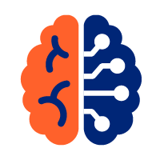
C&S Goals & Hackathon Themes
Goals
Affordability
Productivity
Growth
Experience
$500 million in affordability rate savings
$150 million in productivity savings
Win all RFPs, all markets, all products
Create member experience across all interactions: digital, clinical, text, chat
.
Themes
Cost
Efficiency
AI
Health
Cost improvement & easy access to healthcare
Innovative approaches to automate processes & maximize technology reuse
AI-powered solutions to drive growth
Improve health outcomes via a fulfilling member experience

